Slide 1
Probabilistic Programming
Marius Popescu
popescunmarius@gmail.com
2018 - 2019

Slide 2
Mock Exam | Discussion | Questions

Slide 3
Mock Exam

Slide 4

Question #
Let us assume a probability distribution for count data. Which of the following type of distribution we would choose for modelling:
Bernoulli distribution
Exponential distribution
Poisson distribution

Slide 5
Problem #
Write two different PyMC stochastic variables that can represent a discrete random variable X that takes value in {0, 1, 2, 3, 4, 5}. Which one is the must uninformative?
X = pm.DiscreteUniform(“X", lower = 0, upper = 5)
X = pm.Categorical(“X”, p = [0.1, 0.1, 0.1, 0.2, 0.2, 0.3])
DiscreteUniform (or both if the values of p are equal)

Slide 6
Question #
From the following distribution which one is a conjugate prior for the Bernoulli distribution:
Gamma distribution
Beta distribution
Uniform distribution on (0, 1)

Slide 7
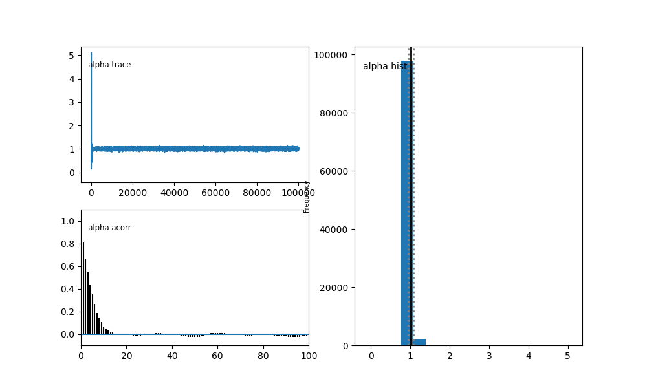
Question #
The figure bellow is the result of pymc.Matplot.plot of a stochastic variable alpha after MCMC. Did the MCMC converged? Justify your answer.
The MCMC has converged. Reasons:
The trace shows that after varying a lot at the beginning (1000 – 2000 iterations) the chain tends toward an equilibrium value, with a smaller variance.
The histogram of the posterior distribution of alpha is concentrated in a small area (around 1)
The autocorrelation becomes and remains small (after lag 16 – 18)

Slide 8
Problem #
import pymc as pm
import numpy as np
import matplotlib.pyplot as plt
true_coin_bias = 0.3 # The (unknown) bias of the coin
num_flips = 100
# The given data, the result of 100 coin flips
data = np.random.choice([0, 1], p=[1-true_coin_bias, true_coin_bias], size=num_flips)
# We want to infer the bias, p. Since p is unknown, it is a random variable.
# The distribution we assign to it here is our prior distribution on p, uniform on the range [0, 1].
p = pm.Uniform("p", lower=0, upper=1)
# We need another random variable for our observations.
# We give the relevant data to the value argument.
# The observed flag stops the value changing during MCMC exploration.
observations = pm.Bernoulli("obs", p=p, value=data, observed=True)
model = pm.Model([p, observations])
mcmc = pm.MCMC(model)
mcmc.sample(60000, 10000) # 60000 steps, with a burn in period of 10000
p_samples = mcmc.trace("p")[:] # Samples from our posterior on p
print()
print(p_samples.mean())
plt.hist(p_samples, bins=40, normed=True)
plt.axvline(x=true_coin_bias, c="k")
plt.xlabel("p")
plt.title("Approximate posterior of p")
plt.xlim(0,1);
plt.show()
Write a PyMC program that infers the bias of a coin given 100 observations of the coin flips

Slide 9
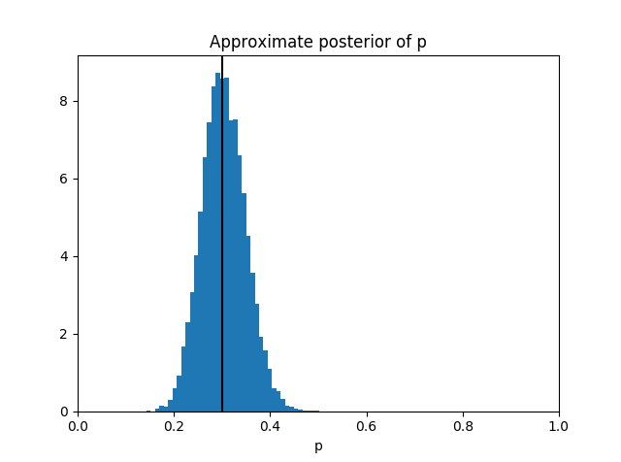

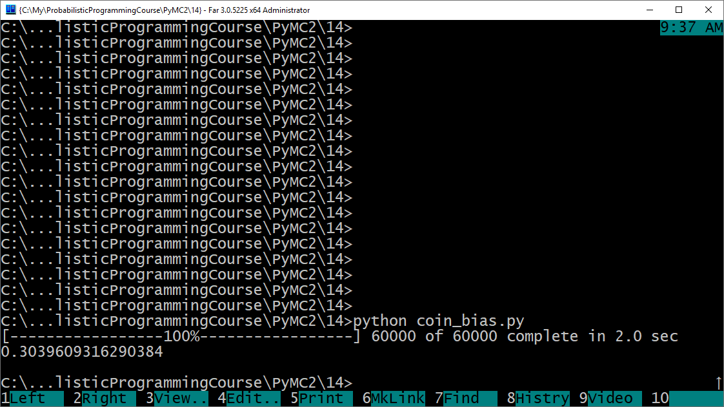

Slide 10
Discussion | Questions

